Slide 1

CSE3151
Computer Networks
(Session 2018-19)
Dr. Asif Zaman
Associate Professor, CSE, RU

Slide 2
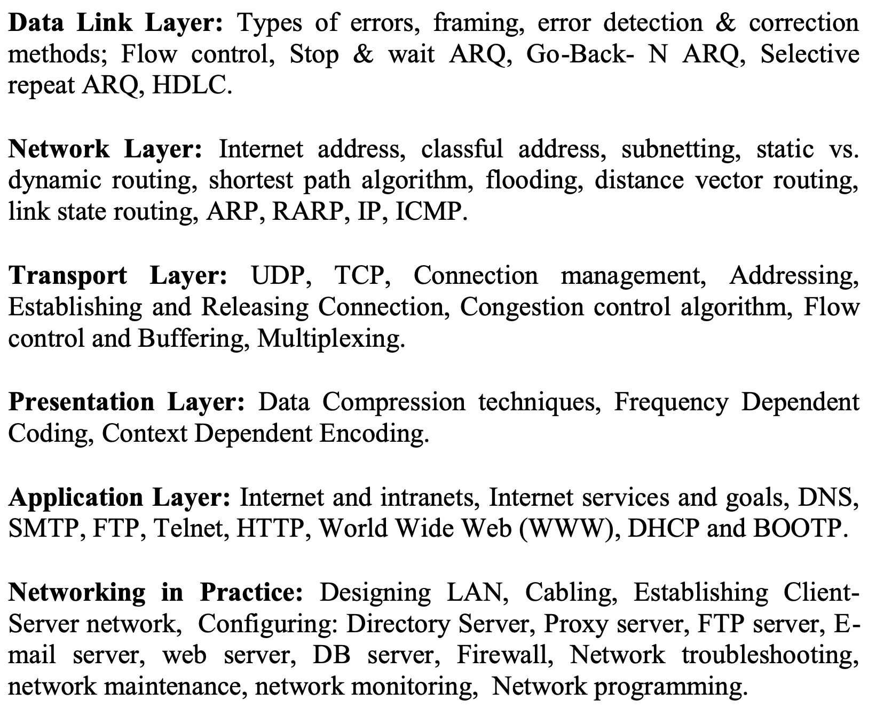
Data Link Layer

Slide 3
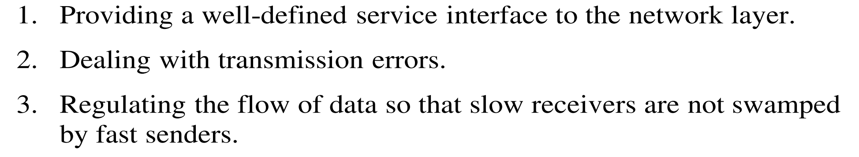
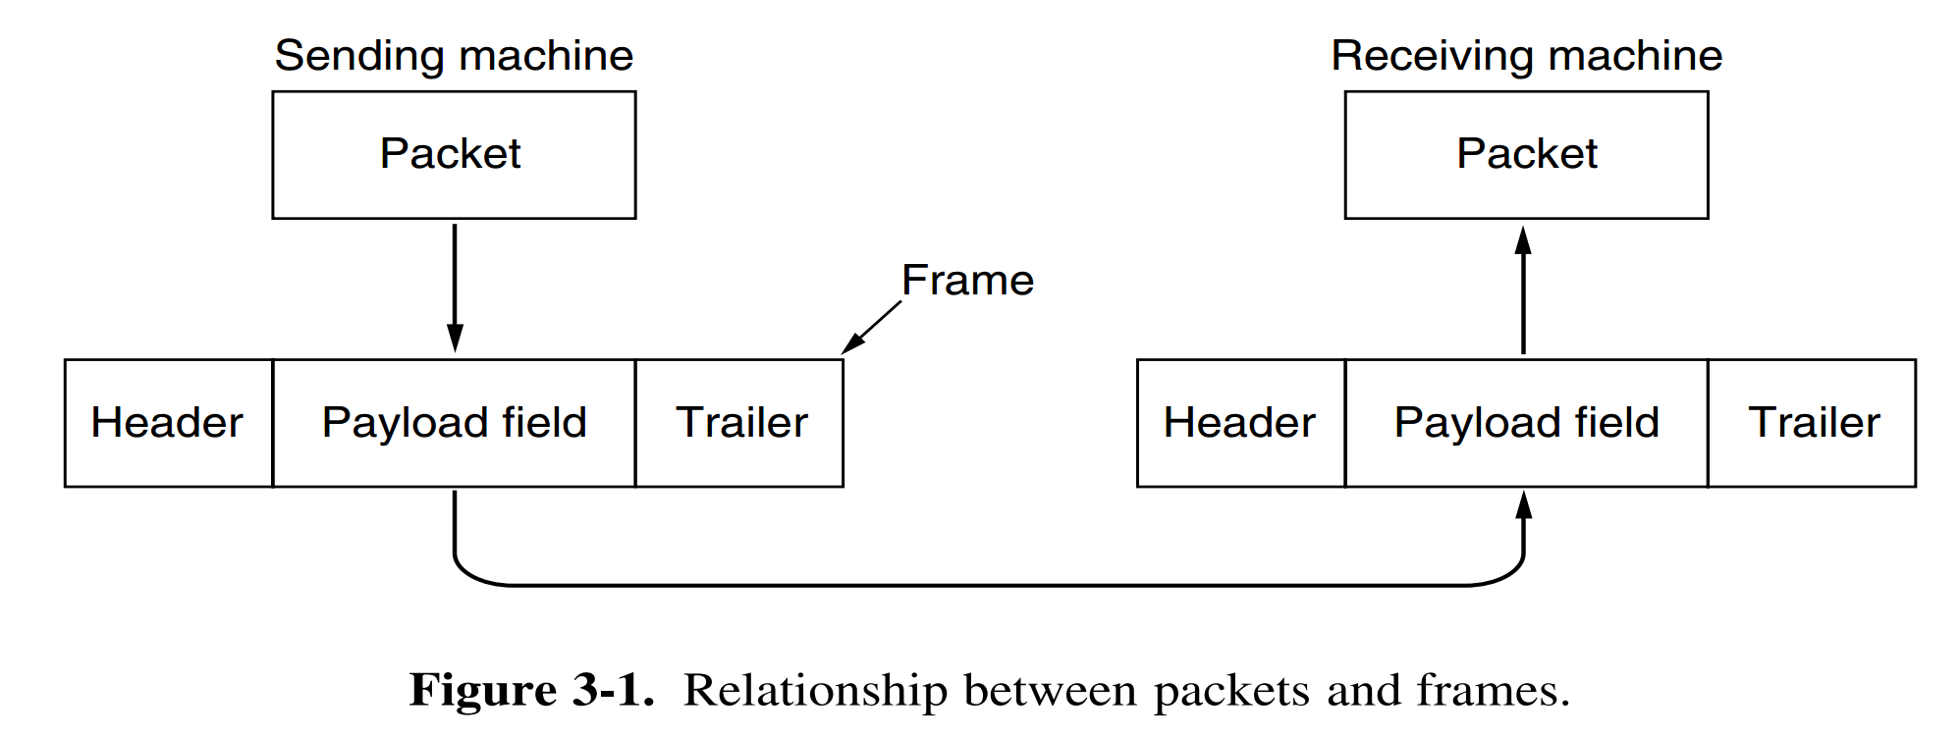
Data Link Layer
This actual data is called the payload.

Slide 4
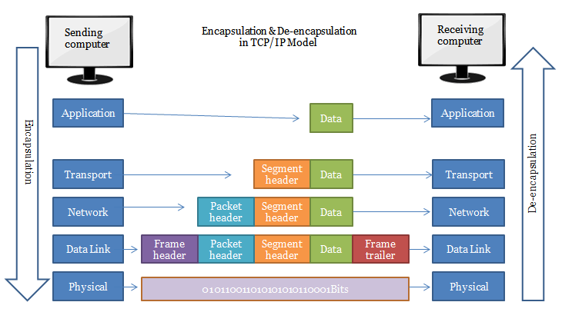

Slide 5
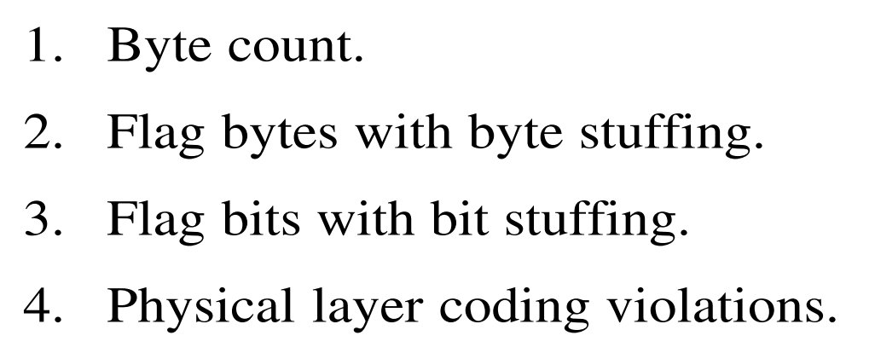
Data Link Layer
Framing:
Breaking up the bit stream into frames
Four methods – very popular

Slide 6
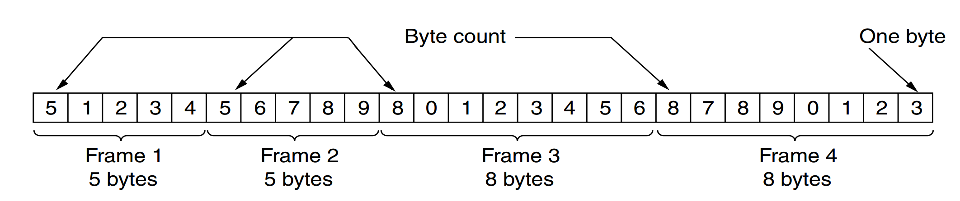
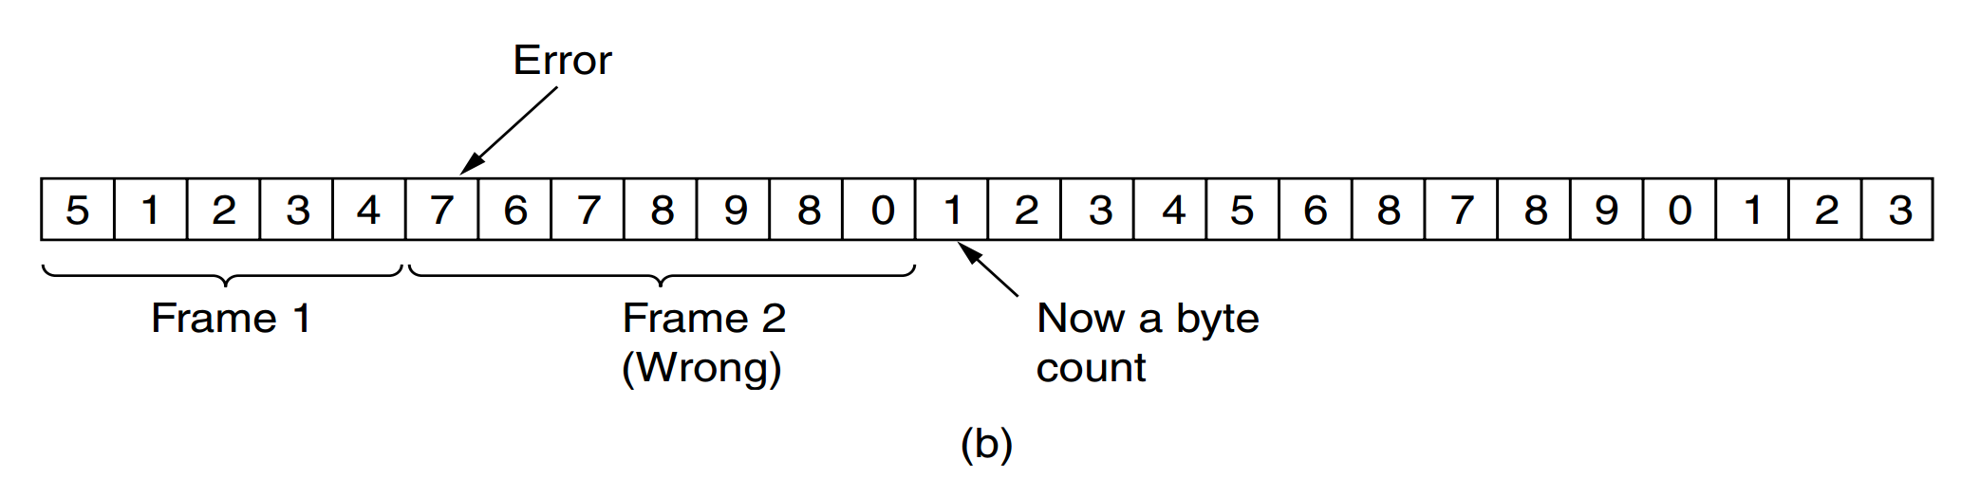
Data Link Layer
Byte Count

Slide 7
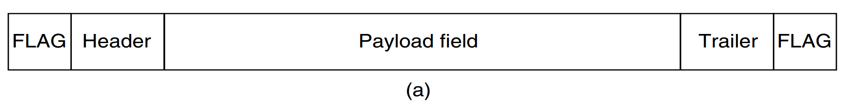
Data Link Layer
Flag Byte with Byte Stuffing
Two consecutive flag bytes indicate the end of one frame and the start of the next.

Slide 8
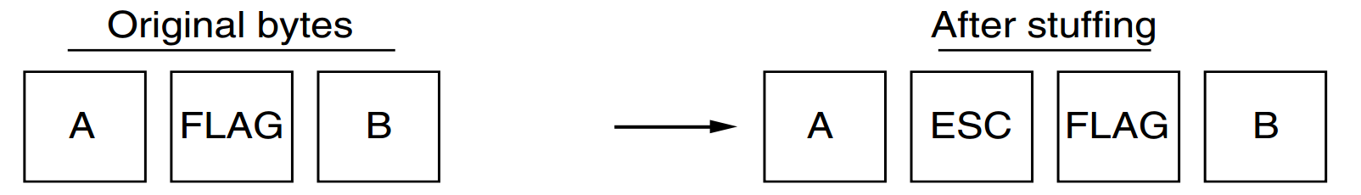
Data Link Layer
It may happen that the flag byte occurs in the data, especially when binary data such as photographs or songs are being transmitted. This situation would interfere with the framing.
One way to solve this problem is to have the sender’s data link layer insert a special escape byte (ESC) just before each ‘‘accidental’’ flag byte in the data. This technique is called byte stuffing

Slide 9
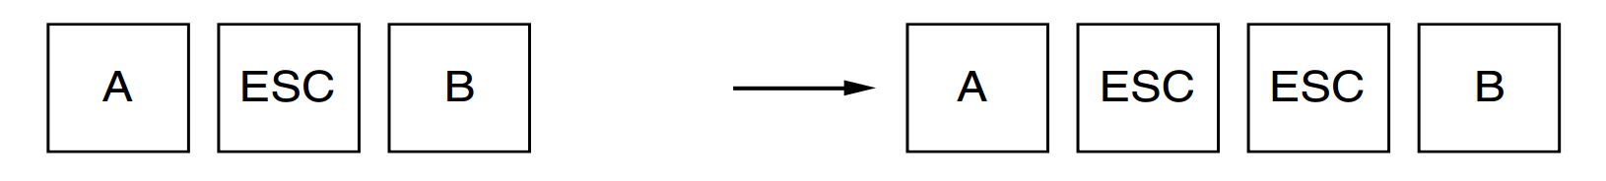

Slide 10
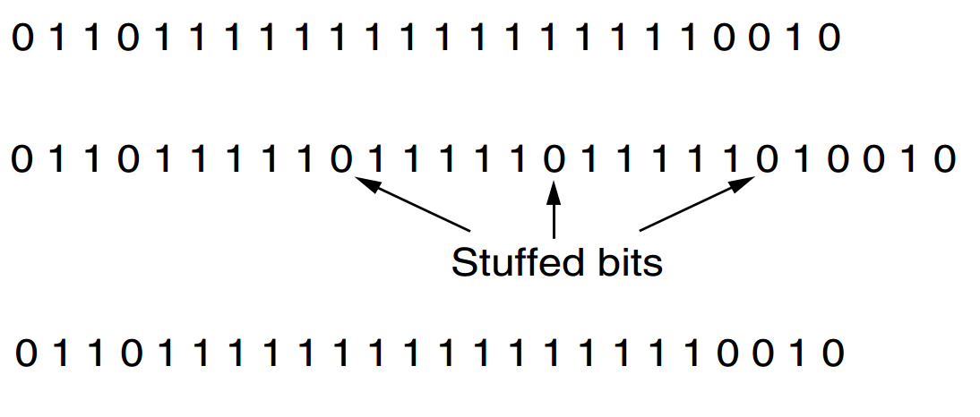
Data Link Layer
Flag bits with bit stuffing
Each frame begins and ends with a special bit pattern, 01111110 or 0x7E in hexadecimal.

Slide 11
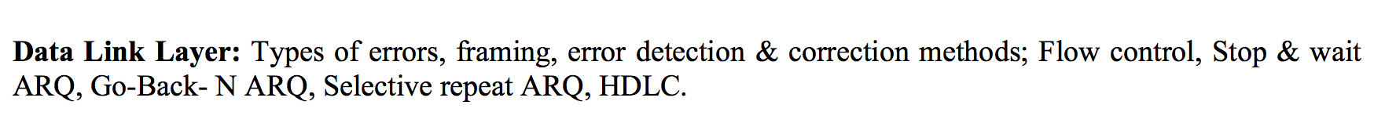
Data Link Layer

Slide 12
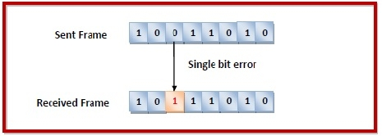
Data Link Layer
Types of Errors
Errors can be of three types, namely
single bit errors,
multiple bit errors, and
burst errors.

Slide 13
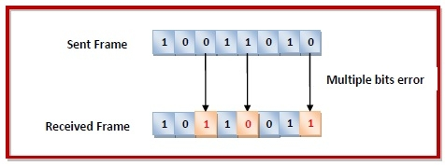
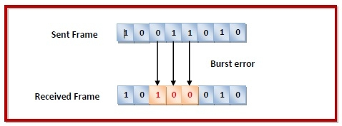
Data Link Layer

Slide 14
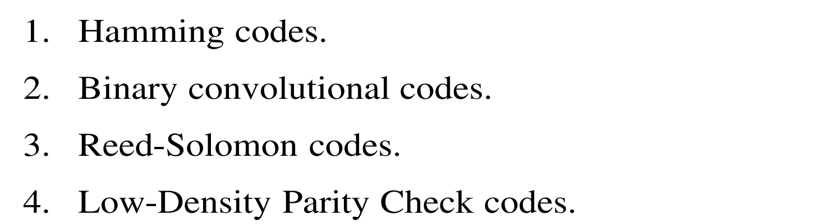
Data Link Layer
Error
error-correcting codes and
error-detecting code
Popular error-correcting codes:

Slide 15
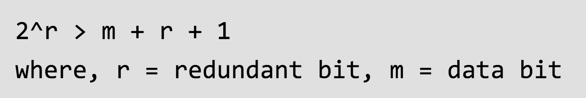
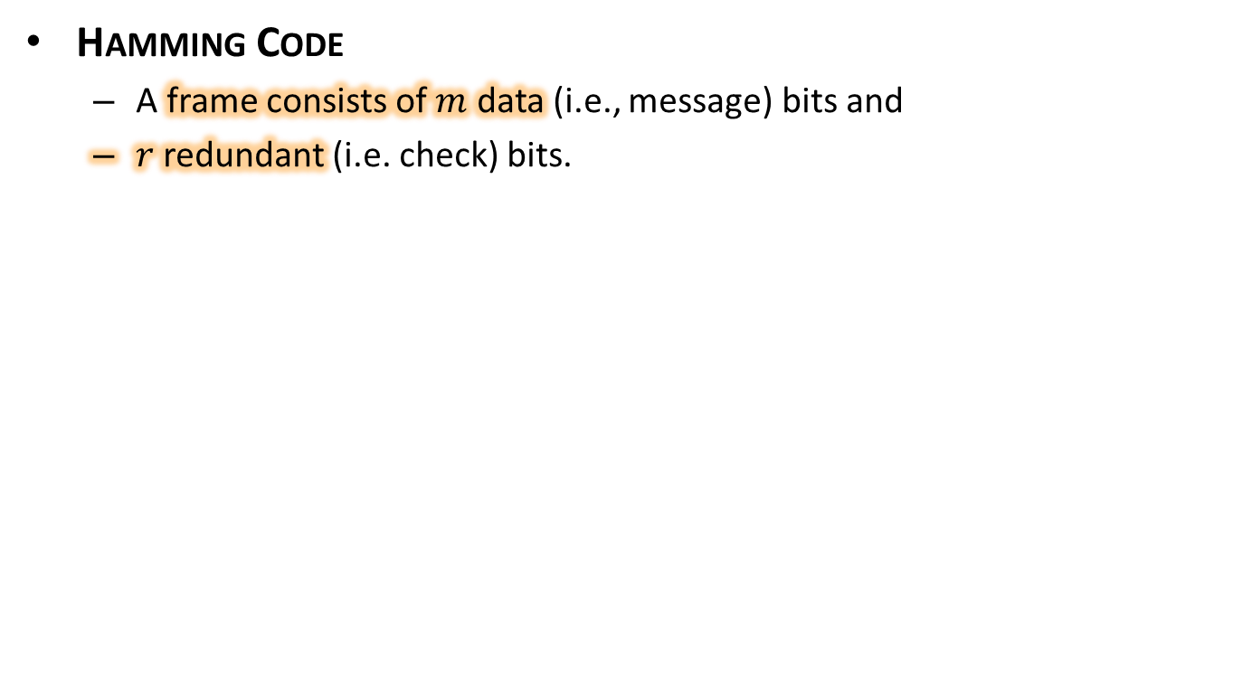
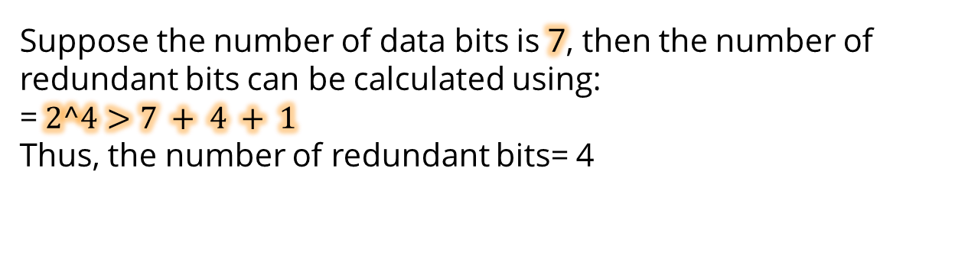
Data Link Layer
Hamming Code
A frame consists of $m$ data (i.e., message) bits and
$r$redundant (i.e. check) bits.
Suppose the number of data bits is 7, then the number of redundant bits can be calculated using: =$2^4>7 + 4 + 1$ Thus, the number of redundant bits= 4

Slide 16
Hamming Code
Parity bits –
A parity bit is a bit appended to a data of binary bits to ensure that the total number of 1’s in the data are even or odd. Parity bits are used for error detection.
There are two types of parity bits:
Odd parity
Even Parity

Slide 17
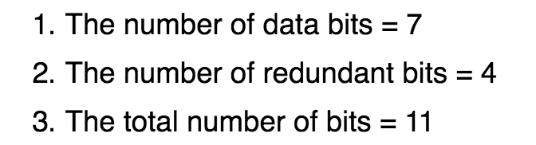
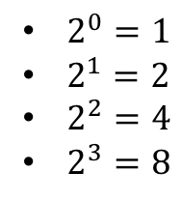
Hamming Code
1011001
11 | 10 | 9 | 8 | 7 | 6 | 5 | 4 | 3 | 2 | 1
$2^{0}=1$
$2^{1}=2$
$2^{2}=4$
$2^{3}=8$
11 | 10 | 9 | 8 | 7 | 6 | 5 | 4 | 3 | 2 | 1
D11 | D10 | D9 | R8 | D7 | D6 | D5 | R4 | D3 | R2 | R1
1 | 0 | 1 | R8 | 1 | 0 | 0 | R4 | 1 | R2 | R1

Slide 18
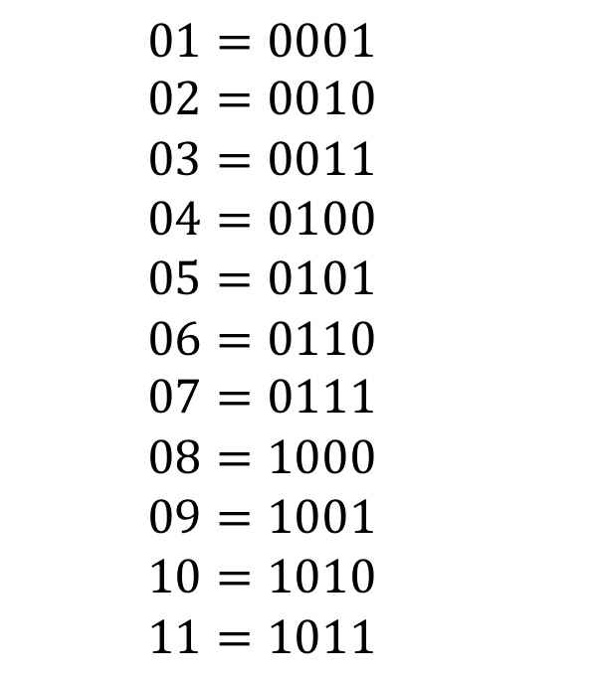
11 | 10 | 9 | 8 | 7 | 6 | 5 | 4 | 3 | 2 | 1
11 | 10 | 9 | 8 | 7 | 6 | 5 | 4 | 3 | 2 | 1
1 | 0 | 1 | R8 | 1 | 0 | 0 | R4 | 1 | R2 | R1
$$01=0001$$
$$02=0010$$
$$03=0011$$
$$04=0100$$
$$05=0101$$
$$06=0110$$
$$07=0111$$
$$08=1000$$
$$09=1001$$
$$10=1010$$
$$11=1011$$

Slide 19
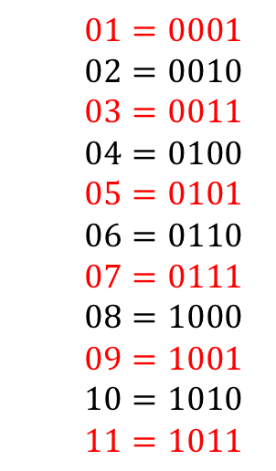
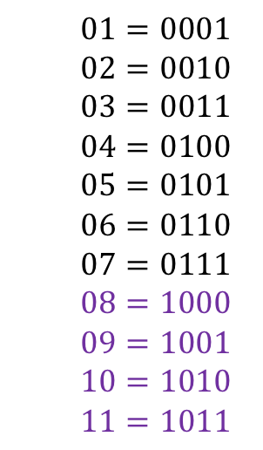
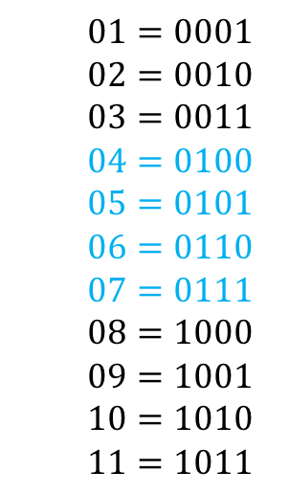
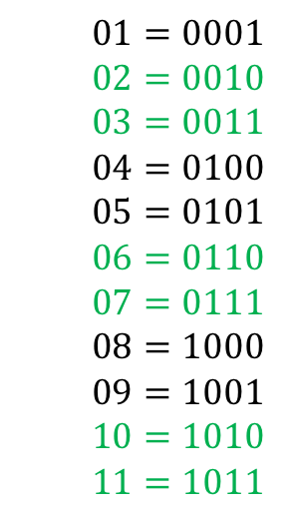
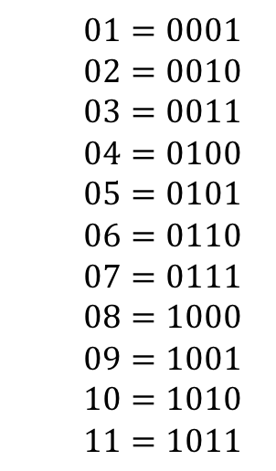
Hamming Code
1 | 0 | 1 | R8 | 1 | 0 | 0 | R4 | 1 | R2 | R1
$$01=0001$$
$$02=0010$$
$$03=0011$$
$$04=0100$$
$$05=0101$$
$$06=0110$$
$$07=0111$$
$$08=1000$$
$$09=1001$$
$$10=1010$$
$$11=1011$$
$$01=0001$$
$$02=0010$$
$$03=0011$$
$$04=0100$$
$$05=0101$$
$$06=0110$$
$$07=0111$$
$$08=1000$$
$$09=1001$$
$$10=1010$$
$$11=1011$$
$$01=0001$$
$$02=0010$$
$$03=0011$$
$$04=0100$$
$$05=0101$$
$$06=0110$$
$$07=0111$$
$$08=1000$$
$$09=1001$$
$$10=1010$$
$$11=1011$$
$$01=0001$$
$$02=0010$$
$$03=0011$$
$$04=0100$$
$$05=0101$$
$$06=0110$$
$$07=0111$$
$$08=1000$$
$$09=1001$$
$$10=1010$$
$$11=1011$$
$$01=0001$$
$$02=0010$$
$$03=0011$$
$$04=0100$$
$$05=0101$$
$$06=0110$$
$$07=0111$$
$$08=1000$$
$$09=1001$$
$$10=1010$$
$$11=1011$$

Slide 20
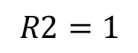
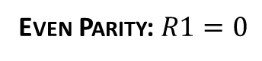
Even Parity: $R1=0$
11 | 10 | 9 | 8 | 7 | 6 | 5 | 4 | 3 | 2 | 1
1 | 0 | 1 | R8 | 1 | 0 | 0 | R4 | 1 | R2 | R1
1 | 0 | 1 | R8 | 1 | 0 | 0 | R4 | 1 | R2 | 0
1 | 0 | 1 | R8 | 1 | 0 | 0 | R4 | 1 | R2 | 0
1 | 0 | 1 | R8 | 1 | 0 | 0 | R4 | 1 | 1 | 0
$$R2=1$$
1 | 0 | 1 | R8 | 1 | 0 | 0 | R4 | 1 | 1 | 0
1 | 0 | 1 | R8 | 1 | 0 | 0 | 1 | 1 | 1 | 0
1 | 0 | 1 | R8 | 1 | 0 | 0 | 1 | 1 | 1 | 0
1 | 0 | 1 | 0 | 1 | 0 | 0 | 1 | 1 | 1 | 0

Slide 21
Sender
1 | 0 | 1 | 0 | 1 | 0 | 0 | 1 | 1 | 1 | 0
1 | 0 | 1 | 0 | 1 | 1 | 0 | 1 | 1 | 1 | 0
11 | 10 | 9 | 8 | 7 | 6 | 5 | 4 | 3 | 2 | 1
1 | 0 | 1 | 0 | 1 | 1 | 0 | 1 | 1 | 1 | 0
0
1 | 0 | 1 | 0 | 1 | 1 | 0 | 1 | 1 | 1 | 0
1
1 | 0 | 1 | 0 | 1 | 1 | 0 | 1 | 1 | 1 | 0
1
1 | 0 | 1 | 0 | 1 | 1 | 0 | 1 | 1 | 1 | 0
0
https://www.geeksforgeeks.org/hamming-code-in-computer-network/

Slide 22
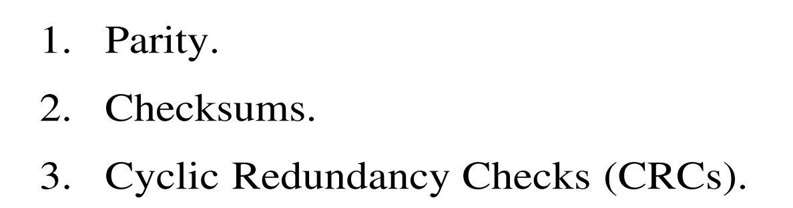
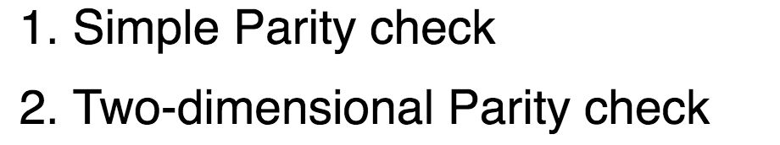
Error Detection
Error Detection

Slide 23
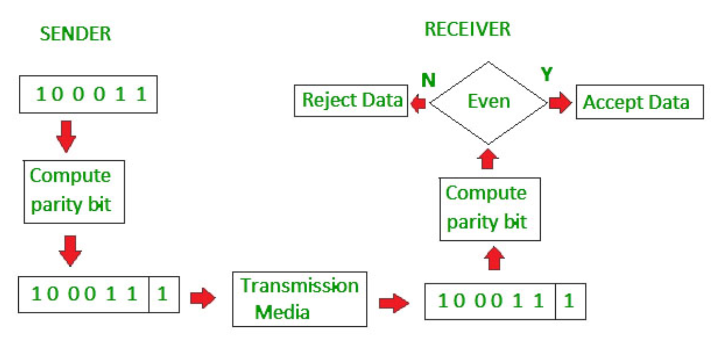
Error Detection
Simple Parity Check

Slide 24
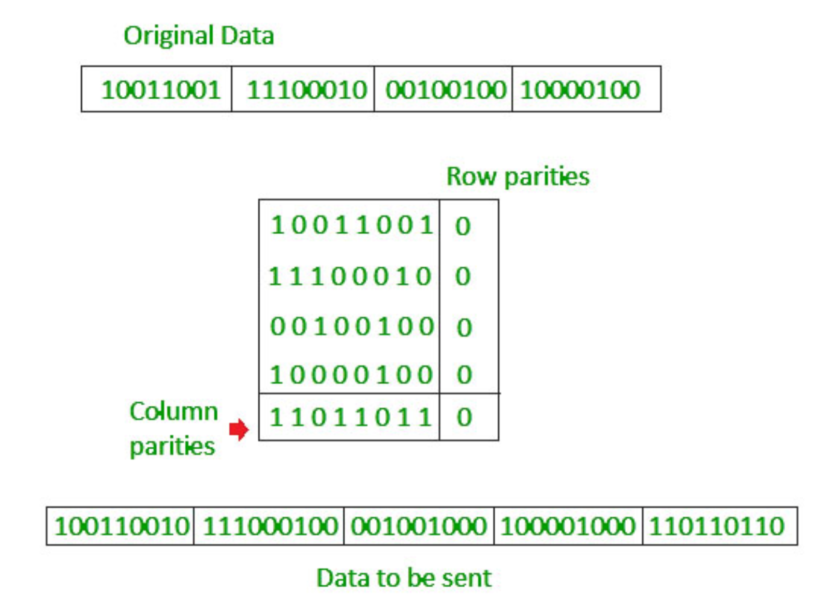
Error Detection
Two Dimensional Parity Check

Slide 25
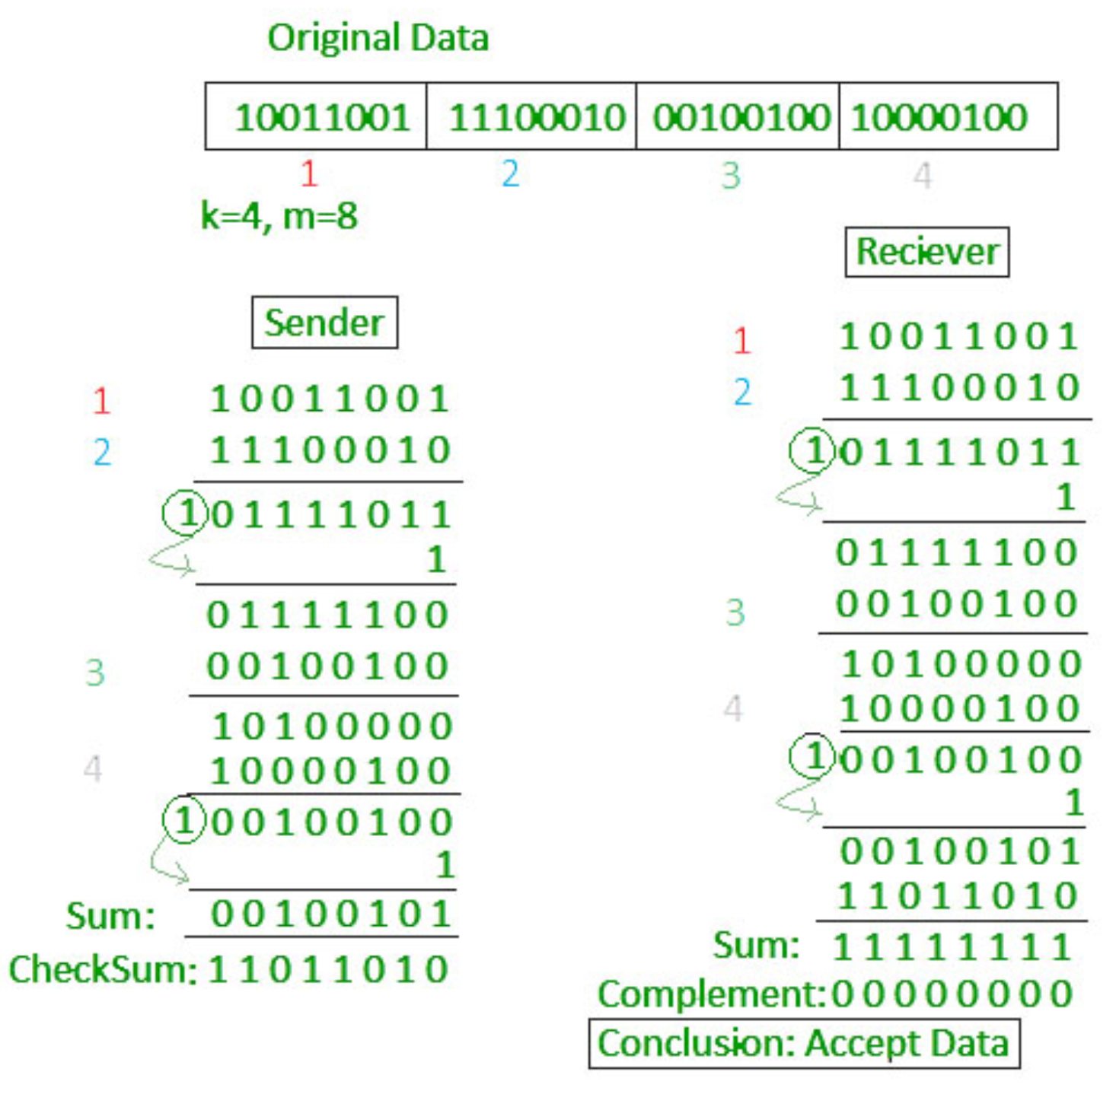
Error Detection
Checksum:
https://www.geeksforgeeks.org/error-detection-in-computer-networks/

Slide 26
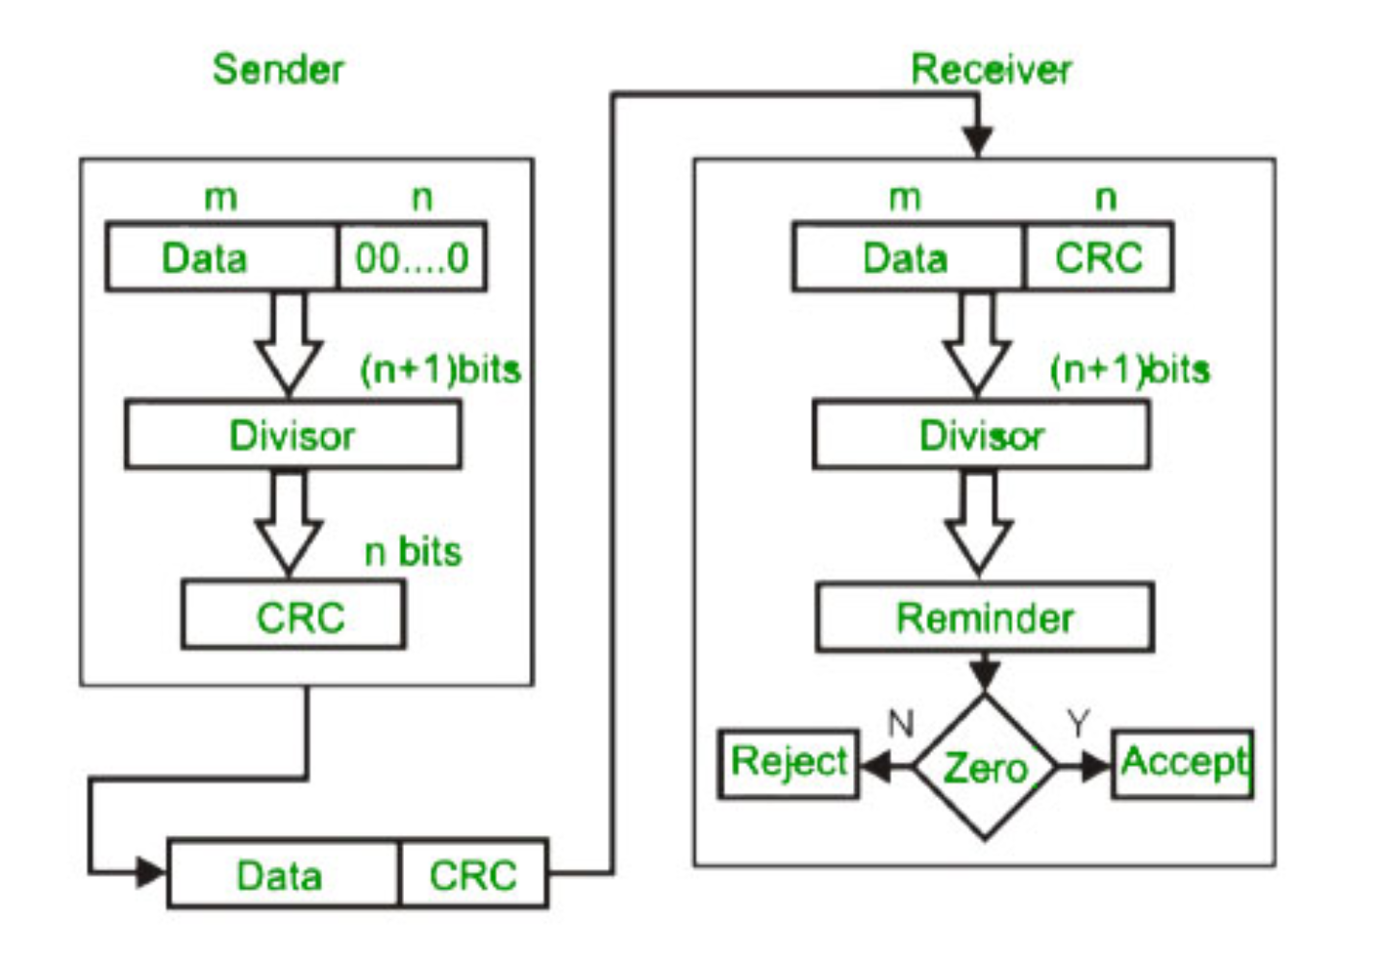
Error Detection
CRC:
https://www.geeksforgeeks.org/error-detection-in-computer-networks/

Slide 27
